Slide 1
ESFP-II Project
Team 3
Team Members
Krupal Patel
Yash Prajapati
Nitish Sharma

Slide 2
Question
Implement File handling concept to Enter a word/docx file and perform following task.
1. Count and display the total number of characters
2. Count and display the total number of blank spaces.
3. Count and display the total number of punctuators (,.””,’).
4. Count and display the total number of articles used in the file.
5. Count and display the total number of following parts of speech that is
• Total number of pronouns.
• Total number of interrogative words.
• Total number of adverbs.
6. Count the total number of uppercase and lowercase alphabets.
7. Count the total number of vowels and consonants.
8. Count the total number of total number of words that have at-least two vowels.
9. Count the total number of paragraphs.
Specific task Group Member-1 & 2
1. Count and replace total number of “is” with was in the file.
2. Count and replace total number of blank-space with “$” in the file.
3. Count and replace lowercase alphabets with uppercase

Slide 3
Header files
#include<iostream>
#include<stdio.h>
#include<string.h>
#include<conio.h>

Slide 4
Pre-Defined function used
Strlen() //To get string length
Strcpy() //To copy strings
Strcmp() //To compare strings
Fopen() //To open .txt file
Fclose() //To close .txt file
Gets , printf , cin , cout //for I/O

Slide 5
User-defined function used
count_123() // Counting spaces , characters , punctions
count_4() // Counting articles
count_5() // Counting pronoun , interrogative word , adverb
count_6() // Counting Uppercase and Lowercase Character
count_7() // Counting vowels and consonants
count_8() // Counting words with at least 2 vowels
st_1() // Special Task 1 counting and replacing “is” to “was”
st_2() // Special Task 2 counting and replacing space to $
st_3() // Special Task 3 counting and replacing lowercase to uppercase character

Slide 6
Count_123()
void count_123() //counting character , blank space , punctuators
{
int countchar=0 , countspace=0 , countpunct=0;
char ch;
FILE *fp;
fp=fopen("D:\\xyz.txt","r");
while((ch=fgetc(fp))!=EOF)
{
if(ch==' ')
{
countspace++;
}
else if(ch==39||ch==44||ch==34||ch==46)//39-' || 44-, || 34-" || 46-.
{
countchar++;
countpunct++;
}
else if(ch=='\n')
{
}
else
{
countchar++;
}
}
fclose(fp);
cout<<"\nNo of Characters are : "<<countchar;
cout<<"\nNo of Spaces are : "<<countspace;
cout<<"\nNo of Punction are : "<<countpunct;
}
variable countspace , countchar , countpunct are use for counting number of spaces , character , punctions respectively.
After opening file xyz.txt the function reads each character and check for space punctions and character using if else and incrementing the counter and at last printing it.

Slide 7
Count_4()
void count_4() //counting artical
{
char ch , word[20];
int i=0 , countartical=0;
FILE *fp;
fp=fopen("D:\\xyz.txt","r");
while((ch=fgetc(fp))!=EOF)
{
if(ch==' ' || ch=='\0' || ch=='\n')
{
word[i]='\0';
i=0;
//count=0;
if(strcmp(word, "an") == 0 || strcmp(word, "a") == 0)
{
countartical++;
//strcpy(word, "was");
}
//count=0;
//fprintf(ofp, "%s%c", word , ch);
}
else
{
word[i]=ch;
++i;
}
}
fclose(fp);
cout<<"\nNo of Artical are : "<<countartical;
}
variable countartical are use for counting number of article n the file.
After opening file xyz.txt the function reads each character and and converting it to word. Check word with a and an using strcmp function and counting the number of occurance and printing it.

Slide 8
Count_5()
void count_5() //counting pronouns , interrogatve , adverb
{
int countpro=0 , countintro=0 , countadverb=0 , len=0;
char pronous[24][5]={"I" , "i" , "He" , "he" , "Him" , "him" , "Her" , "her" , "It" , "it" , "Me" , "me" , "She" , "she" , "Them" , "them" , "They" , "they" , "Us" , "us" , "We" , "we" , "You" , "you"};
char intro[16][7]={"What" , "what" , "Where" , "where" , "When" , "when" , "Why" , "why" , "Which" , "which" , "Who" , "who" , "Whose" , "whose" , "How" , "how"};
//char adverb;
FILE *fp;
fp=fopen("D:\\xyz.txt","r");
if (fp==NULL)
{
printf("no such file.");
}
char word[100];
while (fscanf(fp," %s ",word)==1)
{
for(int j=0 ; j<24 ; ++j) //counting pronouns
{
if(strcmp(pronous[j] , word)==0)
{
countpro++;
}
}
for(int j=0 ; j<16 ; ++j) //counting interrogrative
{
if(strcmp(intro[j] , word)==0)
{
countintro++;
}
}
len = strlen(word);
if(word[len-1]=='y' && word[len-2]=='l') //counting adverb
{
countadverb++;
}
}
fclose(fp);
cout<<"\nNo of Pronouns are : "<<countpro;
cout<<"\nNo of Interrogatives are : "<<countintro;
cout<<"\nNo of Adverbs are : "<<countadverb;
}
variable countpro , countintro , countadverb are use for counting number of pronoun , interrogative word , adverb respectively in the file.
After opening file xyz.txt the function reads each character and and converting it to word. Check is word is Pronoun , interrogative word , adverb and storing there value in variable and printing it.

Slide 9
Count_6()
void count_6() //counting uppercase and lowercase
{
int countupper=0 , countlower=0;
char ch;
FILE *fp;
fp=fopen("D:\\xyz.txt","r");
while((ch=fgetc(fp))!=EOF)
{
if(ch>=97&&ch<=122)
{
countlower++;
}
else if(ch>=65&&ch<=90)
{
countupper++;
}
}
fclose(fp);
cout<<"\nNo of Uppercase Alphabet are : "<<countupper;
cout<<"\nNo of Lowercase Alphabet are : "<<countlower;
}
variable countupper , countlower are use for counting number of uppercase and lowercase character in the file.
After opening file xyz.txt the function reads each character and checking is the character is uppercase or lowercase and stoing count in particular variable and printing it.

Slide 10
Count_7()
void count_7() //counting vowels and consonants
{
int countvowel=0 , countcons=0;
char ch;
FILE *fp;
fp=fopen("D:\\xyz.txt","r");
while((ch=fgetc(fp))!=EOF)
{
if((ch>=97&&ch<=122) || (ch>=65&&ch<=90))
{
if(ch=='a'||ch=='e'||ch=='i'||ch=='o'||ch=='u'||ch=='A'||ch=='E'||ch=='I'||ch=='O'||ch=='U')
{
countvowel++;
}
else
{
countcons++;
}
}
}
fclose(fp);
cout<<"\nNo of vowels are : "<<countvowel;
cout<<"\nNo of consonants are : "<<countcons;
}
variable countvowel , countcons are use for counting number of vowels and consonants character in the file.
After opening file xyz.txt the function reads each character and checking is the character is vowel or consonants and storing count in particular variable and printing it.

Slide 11
Count_8()
void count_8() //counting word with atleast 2 vowels
{
char ch , word[20];
int i=0 , countword=0 , count=0;
FILE *fp;
fp=fopen("D:\\xyz.txt","r");
while((ch=fgetc(fp))!=EOF)
{
if(ch==' ' || ch=='\0' || ch=='\n')
{
word[i]='\0';
i=0;
if(count>=2)
{
countword++;
//strcpy(word, "was");
}
count=0;
//fprintf(ofp, "%s%c", word , ch);
}
else
{
word[i]=ch;
++i;
if(ch=='a'||ch=='e'||ch=='i'||ch=='o'||ch=='u'||ch=='A'||ch=='E'||ch=='I'||ch=='O'||ch=='U')
{
count++;
}
}
}
fclose(fp);
cout<<"\nNo of word with more than two vowel are : "<<countword;
}
variable countword is use for counting number of words with at least two vowels in the file.
After opening file xyz.txt and reading word from it after that counting number of vowels in the word and if vowel count is greater or equal to two then countword is increased after that printing the final count.

Slide 12
St_1()
void st_1() //changing 'is' to 'was' and counting no of is
{
FILE *ifp, *ofp;
char ch, word[100];
int countis=0 , i=0;
ifp = fopen("D:\\xyz.txt", "r");
ofp = fopen("D:\\change.txt", "w");
if (ifp == NULL || ofp == NULL) {
printf("Can't open file.");
exit(0);
}
// comparing word with file
//rewind(ifp);
while((ch=fgetc(ifp))!=EOF)
{
if(ch==' ' || ch=='\0' || ch=='\n')
{
word[i]='\0';
i=0;
//count=0;
if(strcmp(word, "is") == 0)
{
countis++;
strcpy(word, "was");
}
fprintf(ofp, "%s%c", word , ch);
}
else
{
word[i]=ch;
++i;
}
}
fclose(ifp);
fclose(ofp);
rename("D:\\change.txt", "D:\\temp.txt");
remove("D:\\change.txt");
remove("D:\\xyz.txt");
rename("D:\\temp.txt", "D:\\xyz.txt");
remove("D:\\temp.txt");
cout<<"\nNo of is are : "<<countis;
}
variable countis is use for counting number of “is” in the file and replacing it with “was”.
We have used two pointers in this one to read file xyz.txt and one to rite change.txt. We are sampling coping whole file word by word and if there is “is” it replace it with “was” and count the number of times “is” there in file , the old file is removed and new file is renamed with xyz.txt

Slide 13
St_2()
void st_2() //changing "space" to '$' and counting no of space
{
FILE *ifp, *ofp;
char ch;
int countspace=0;
ifp = fopen("D:\\xyz.txt", "r");
ofp = fopen("D:\\change.txt", "w");
if (ifp == NULL || ofp == NULL) {
printf("Can't open file.");
exit(0);
}
// comparing word with file
//rewind(ifp);
while((ch=fgetc(ifp))!=EOF)
{
// fscanf(ifp, "%c", ch);
if (ch==32){
countspace++;
// for deleting the word
ch=36;
}
// In last loop it runs twice
fprintf(ofp, "%c", ch);
}
fclose(ifp);
fclose(ofp);
rename("D:\\change.txt", "D:\\temp.txt");
remove("D:\\change.txt");
remove("D:\\xyz.txt");
rename("D:\\temp.txt", "D:\\xyz.txt");
remove("D:\\temp.txt");
cout<<"\nNo of space are : "<<countspace;
}
variable countspace is use for counting number of “ ” in the file and replacing it with “$”.
We have used two pointers in this one to read file xyz.txt and one to write change.txt. We are sampling coping whole file word by word and if there is “ ” it replace it with “$” and count the number of times “ ” there in file , the old file is removed and new file is renamed with xyz.txt

Slide 14
St_3()
void st_3() //changing 'lowwercase alphabet' to 'uppercase alphabet'and counting no of lowwercase alphabet
{
FILE *ifp, *ofp;
char ch;
int lowercase=0;
ifp = fopen("D:\\xyz.txt", "r");
ofp = fopen("D:\\change.txt", "w");
if (ifp == NULL || ofp == NULL) {
printf("Can't open file.");
exit(0);
}
// comparing word with file
//rewind(ifp);
while((ch=fgetc(ifp))!=EOF)
{
// fscanf(ifp, "%c", ch);
if (ch>=97&&ch<=122){
lowercase++;
// for deleting the word
ch -=32;
}
// In last loop it runs twice
fprintf(ofp, "%c", ch);
}
fclose(ifp);
fclose(ofp);
rename("D:\\change.txt", "D:\\temp.txt");
remove("D:\\change.txt");
remove("D:\\xyz.txt");
rename("D:\\temp.txt", "D:\\xyz.txt");
remove("D:\\temp.txt");
cout<<"\nNo of lowercases are : "<<lowercase;
}
variable lowercase is use for counting number of lowercase character in the file and replacing it with uppercase character.
We have used two pointers in this one to read file xyz.txt and one to write change.txt. We are coping whole file character by character and if there is a lowercase character then it replace it with uppercase character and count the number lowercase character there in file , the old file is removed and new file is renamed with xyz.txt

Slide 15
Int main()
int main()
{
FILE *fp;
int n , countpara=1;
char name[100];
//System(“cls”);
fp=fopen("D:\\xyz.txt","w");
if (fp==NULL)
{
printf("File does not exist");
return 0;
}
printf("Enter no of lines you want to enter : ");
cin>>n;
cout<<"=========================================E N T E R Y O U R T E X T==============================\n";
//cout<<"1";
gets(name);
gets(name);
if(strcmp(name,"\0")==0) //count_9 counting Paragraph
{
countpara++;
}
fprintf(fp,"%s\n",name);
for(int i=1 ; i<n ; ++i)
{
//cout<<i+1;
gets(name);
if(strcmp(name,"\0")==0)
{
countpara++;
}
fprintf(fp,"%s\n",name);
}
fclose(fp);
system("CLS");
PART – I //reading
Here we are reading text from user in xyz.txt and counting paragraph and storing value in countpara.

Slide 16
Int main()
cout<<"========================S O L U T I O N=============================";
count_123();
count_4();
count_5();
count_6();
count_7();
count_8();
cout<<"\nNo of Paragraph are : "<<countpara;
cout<<"\n\n\t\t\tSpecific task\n\n";
st_1();
st_2();
st_3();
// Printing the content of the Output file
cout<<"\n\n\t\t\tOutput .txt file\n\n";
char ch;
fp=fopen("D:\\xyz.txt" , "r");
while (1) {
ch = fgetc(fp);
if (ch == EOF) {
break;
}
printf("%c", ch);
}
fclose(fp);
return 0;
}
PART – II // Solution
Here we are calling the user-defined function created to count characters and etc. and print the final file after changing it in specific task functions

Slide 17
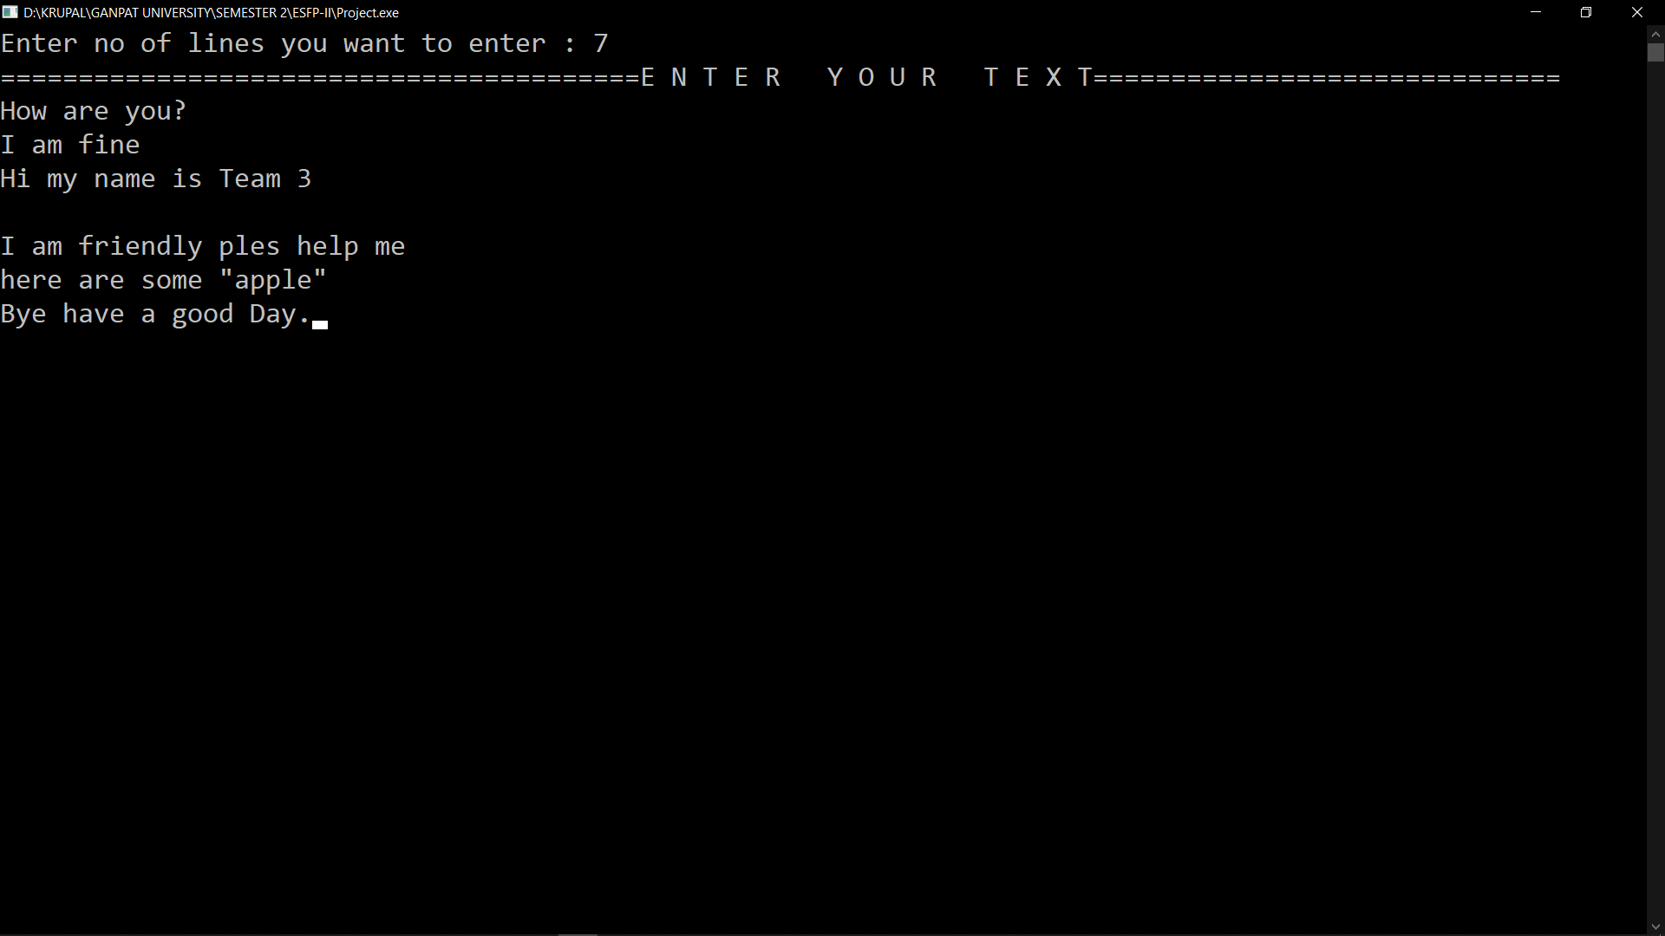
Screenshot - I

Slide 18
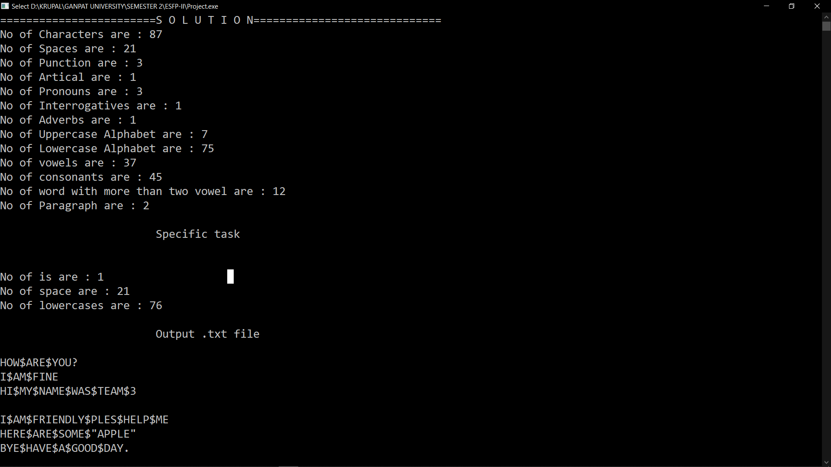
Screenshot - Ii

Slide 19
Thank you
ESFP – II Project
Team 3

